Slide 1
Tree / Binary Tree

Slide 2
What is a Tree?
A tree is a nonlinear data structure with hierarchical relationships between its elements without having any cycle, it is basically reversed from a real life tree.
Drinks
Hot
Cold
Tea
Coﬀee
Non alcoholic
Alcoholic
Green
Black
Americano
Latte
Cappuccino
Cola
Fanta
Soda
Wine
Beer

Slide 3
What is a Tree?
A tree is a nonlinear data structure with hierarchical relationships between its elements without having any cycle, it is basically reversed from a real life tree.
Drinks
Hot
Cold
Tea
Coﬀee
Non alcoholic
Alcoholic
Green
Black
Americano
Latte
Cappuccino
Cola
Fanta
Soda
Wine
Beer
Properties:
Represent hierarchical data
Each node has two components : data and a link to its sub category
Base category and sub categories under it

Slide 4
What is a Tree?
A tree is a nonlinear data structure with hierarchical relationships between its elements without having any cycle, it is basically reversed from a real life tree.
N1
N2
N3
N4
N5
N6
N7
N8
Tree Properties:
Represent hierarchical data
Each node has two components : data and a link to its sub category
Base category and sub categories under it

Slide 5


Why Tree?
Quicker and Easier access to the data
Store hierarchical data, like folder structure, organization structure, XML/HTML data.
The file system on a computer

Slide 6
Why Tree?
Quicker and Easier access to the data
Store hierarchical data, like folder structure, organization structure, XML/HTML data.
There are many different types of data structures which performs better in various situations
- Binary Search Tree, AVL, Red Black Tree, Trie

Slide 7
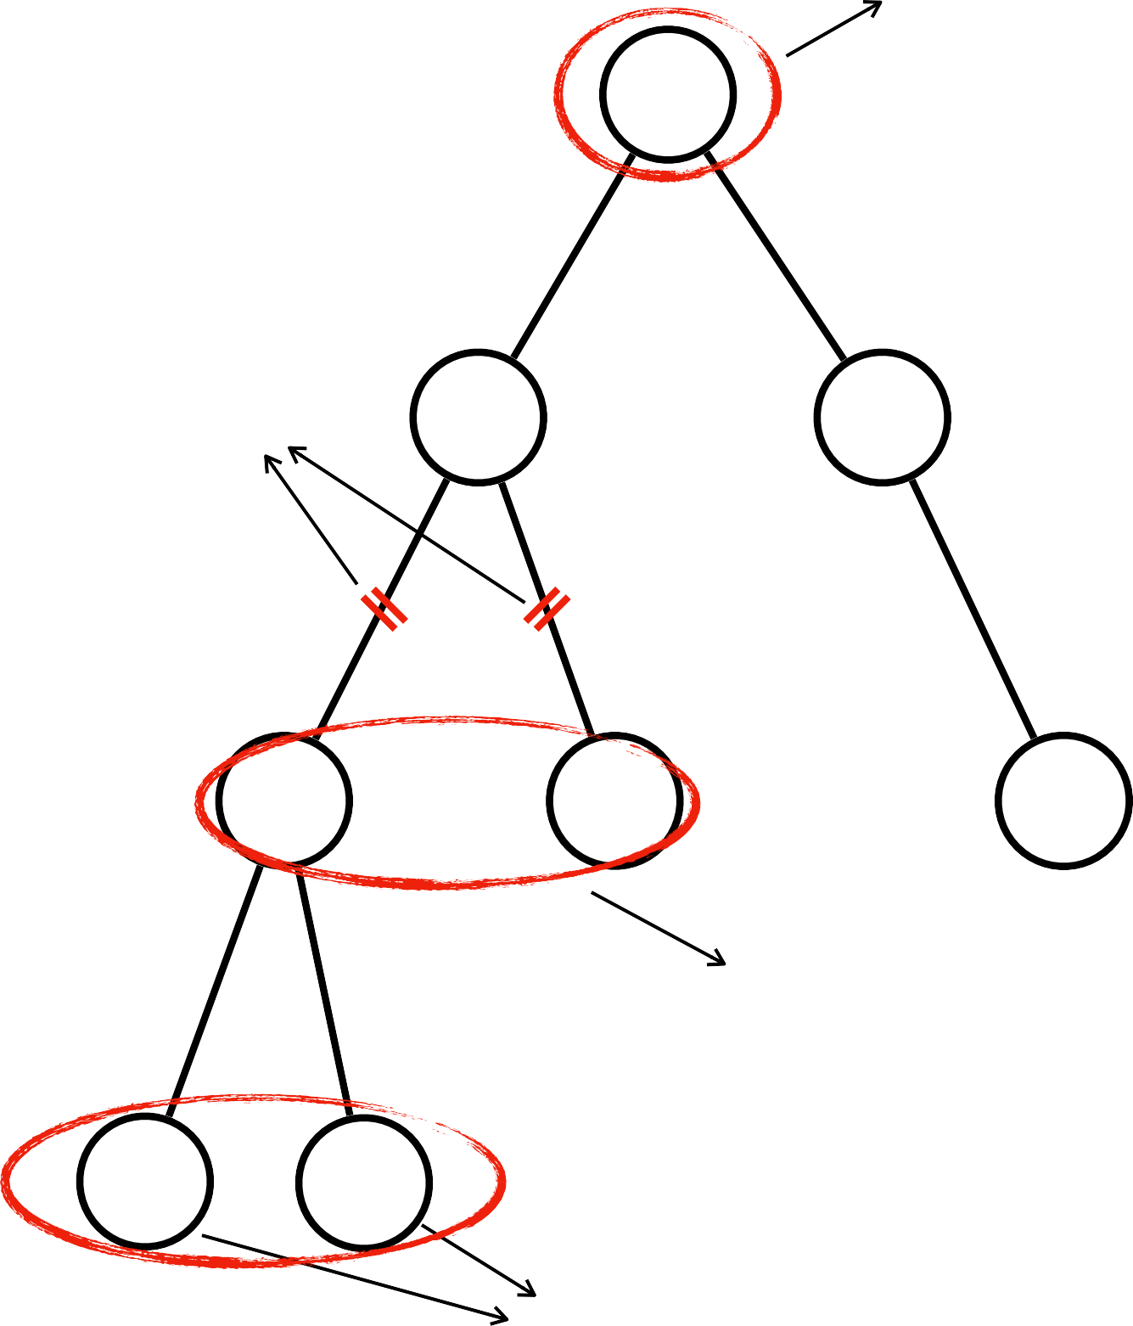
Tree Terminology
root
N1
Root : top node without parent
Edge : a link between parent and child Leaf : a node which does not have children Sibling : children of same parent
Ancestor : parent, grandparent, great grandparent of a node
edge
N2
N3
N4
N5
N6
sibling
N7
N8
leaf

Slide 8
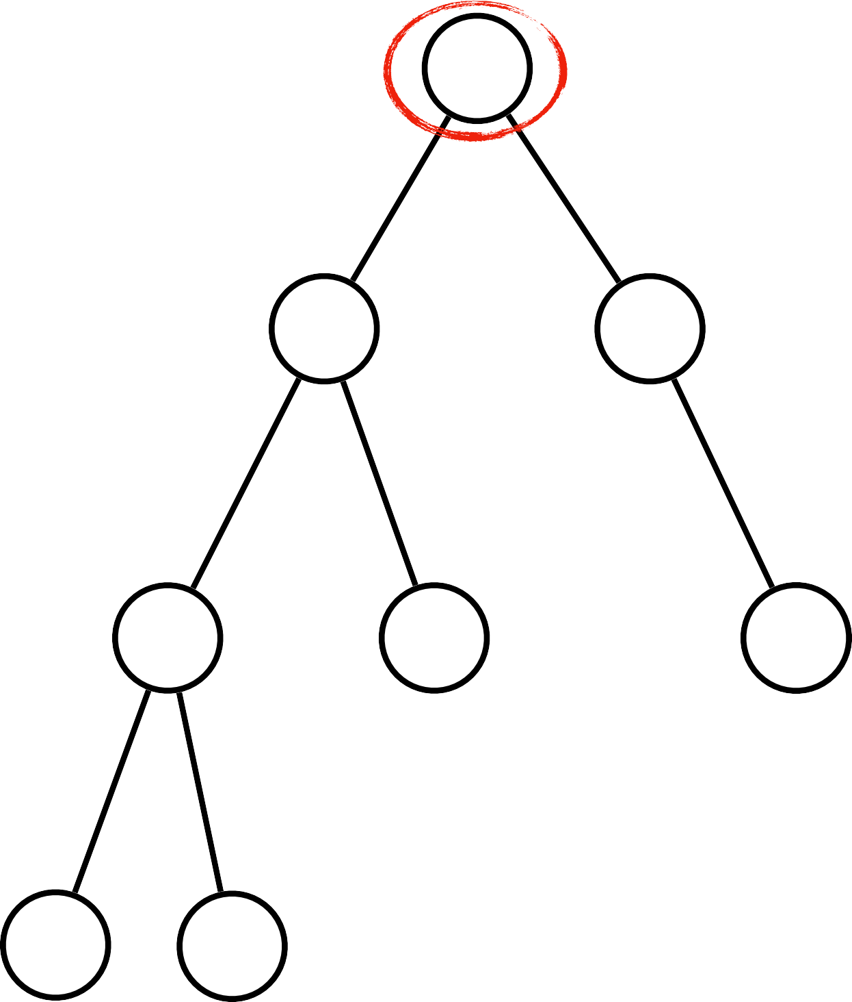


Tree Terminology
N1
Root : top node without parent
Edge : a link between parent and child Leaf : a node which does not have children Sibling : children of same parent
Ancestor : parent, grandparent, great grandparent of a node
N2
N3
ancestors of N7
N4
N5
N6
N7
N8

Slide 9
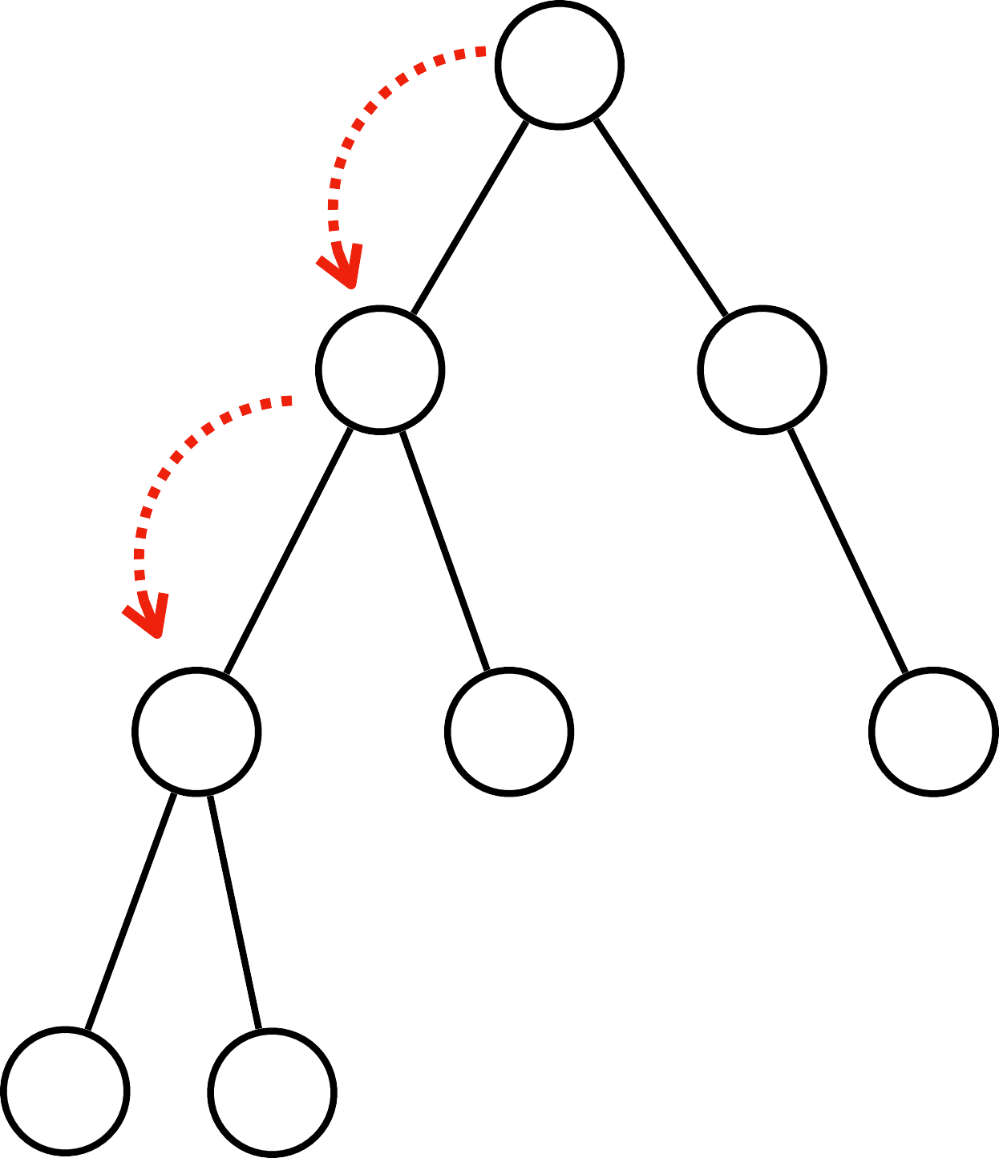
Tree Terminology
N1
Root : top node without parent
Edge : a link between parent and child Leaf : a node which does not have children Sibling : children of same parent
Ancestor : parent, grandparent, great grandparent of a node
Depth of node : a length of the path from root to node
N2
N3
Depth of N4 = 2
N4
N5
N6
N7
N8

Slide 10
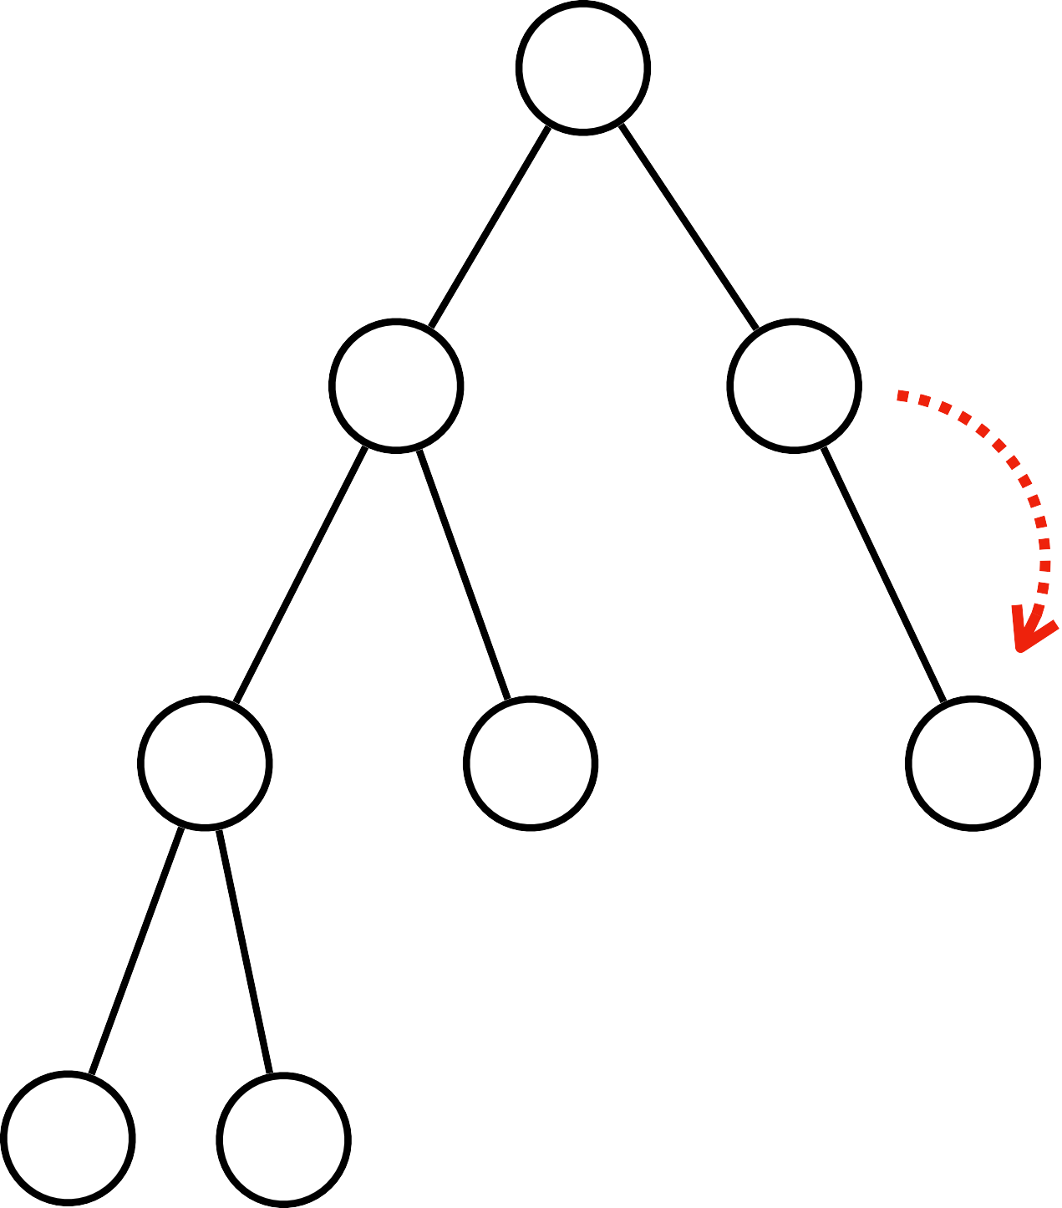
Tree Terminology
N1
Root : top node without parent
Edge : a link between parent and child Leaf : a node which does not have children Sibling : children of same parent
Ancestor : parent, grandparent, great grandparent of a node
Depth of node : a length of the path from root to node
Height of node : a length of the path from the node to the deepest node
N2
N3
Heigh of N3 = 1
N4
N5
N6
N7
N8

Slide 11
Tree Terminology
N1
Root : top node without parent
Edge : a link between parent and child Leaf : a node which does not have children Sibling : children of same parent
Ancestor : parent, grandparent, great grandparent of a node
Depth of node : a length of the path from root to node
Height of node : a length of the path from the node to the deepest node
Depth of tree : depth of root node
N4
N2
N3
N5
N6
Depth of tree = 0
N7
N8

Slide 12
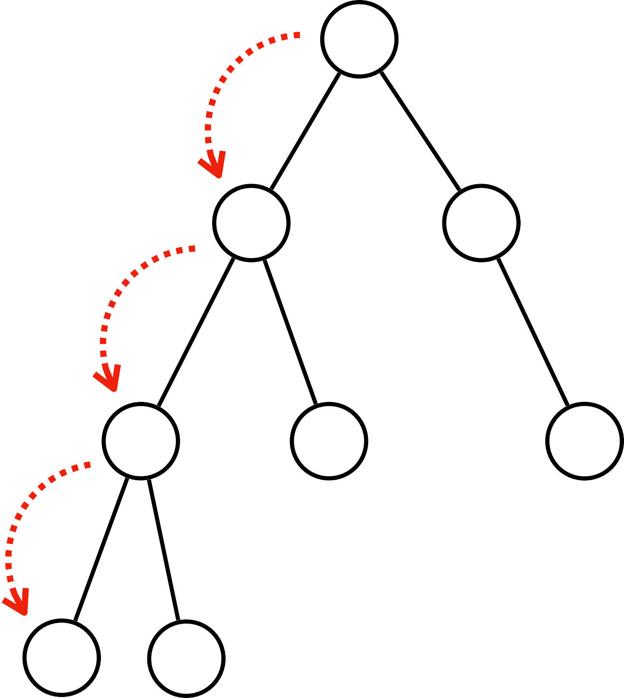
Tree Terminology
N1
Root : top node without parent
Edge : a link between parent and child Leaf : a node which does not have children Sibling : children of same parent
Ancestor : parent, grandparent, great grandparent of a node
Depth of node : a length of the path from root to node
Height of node : a length of the path from the node to the deepest node
Depth of tree : depth of root node
N2
N3
Height of tree : height of root node
N4
N5
N6
Height of tree = 3
N7
N8

Slide 13
Binary Tree
Binary trees are the data structures in which each node has at most two children, often referred to as the left and right children
Binary tree is a family of data structure (BST, Heap tree, AVL, red black trees, Syntax tree)
N1
N2
N3
N4
N5
N6
N7
N8

Slide 14
Why Binary Tree?
Binary trees are a prerequisite for mode advanced trees like BST, AVL, Red Black Trees
Huffman coding problem , heap priority problem and expression parsing problems can be solved efficiently using binary trees,
N1
N2
N3
N4
N5
N6
N7
N8

Slide 15
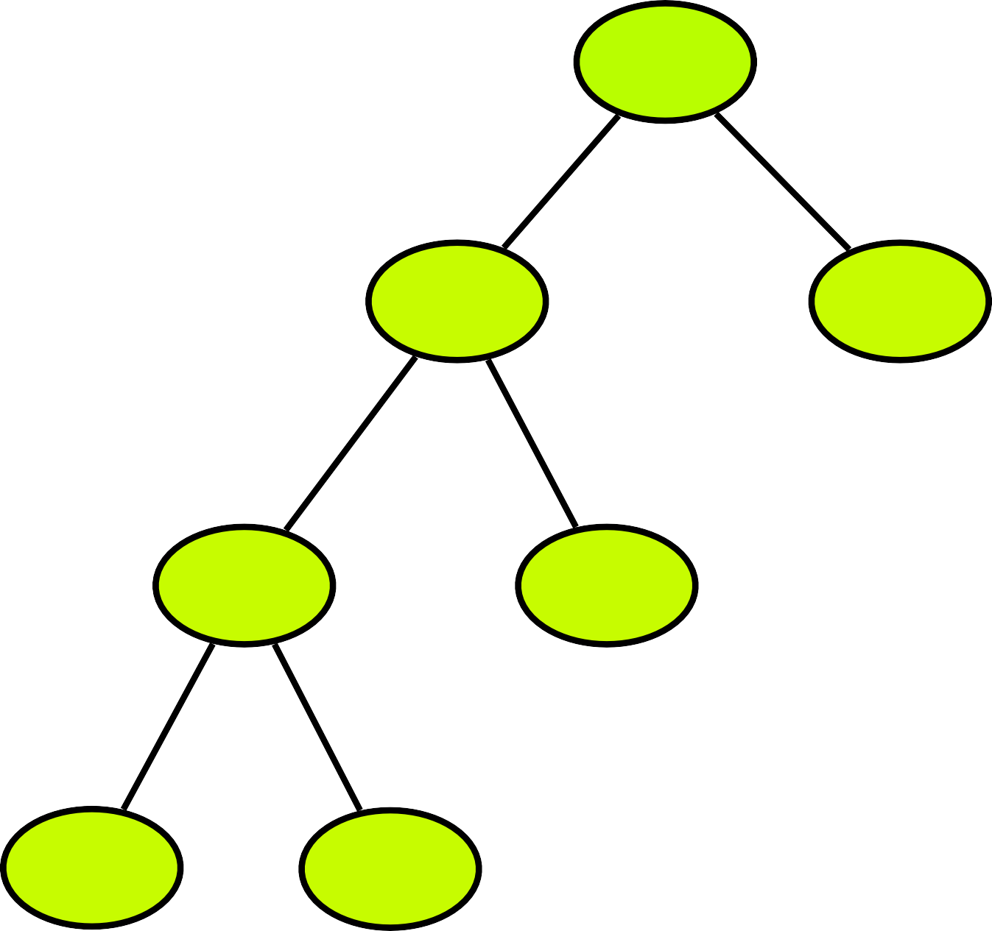
Types of Binary Tree
Full Binary Tree
N1
N2
N3
N4
N5
N6
N7

Slide 16
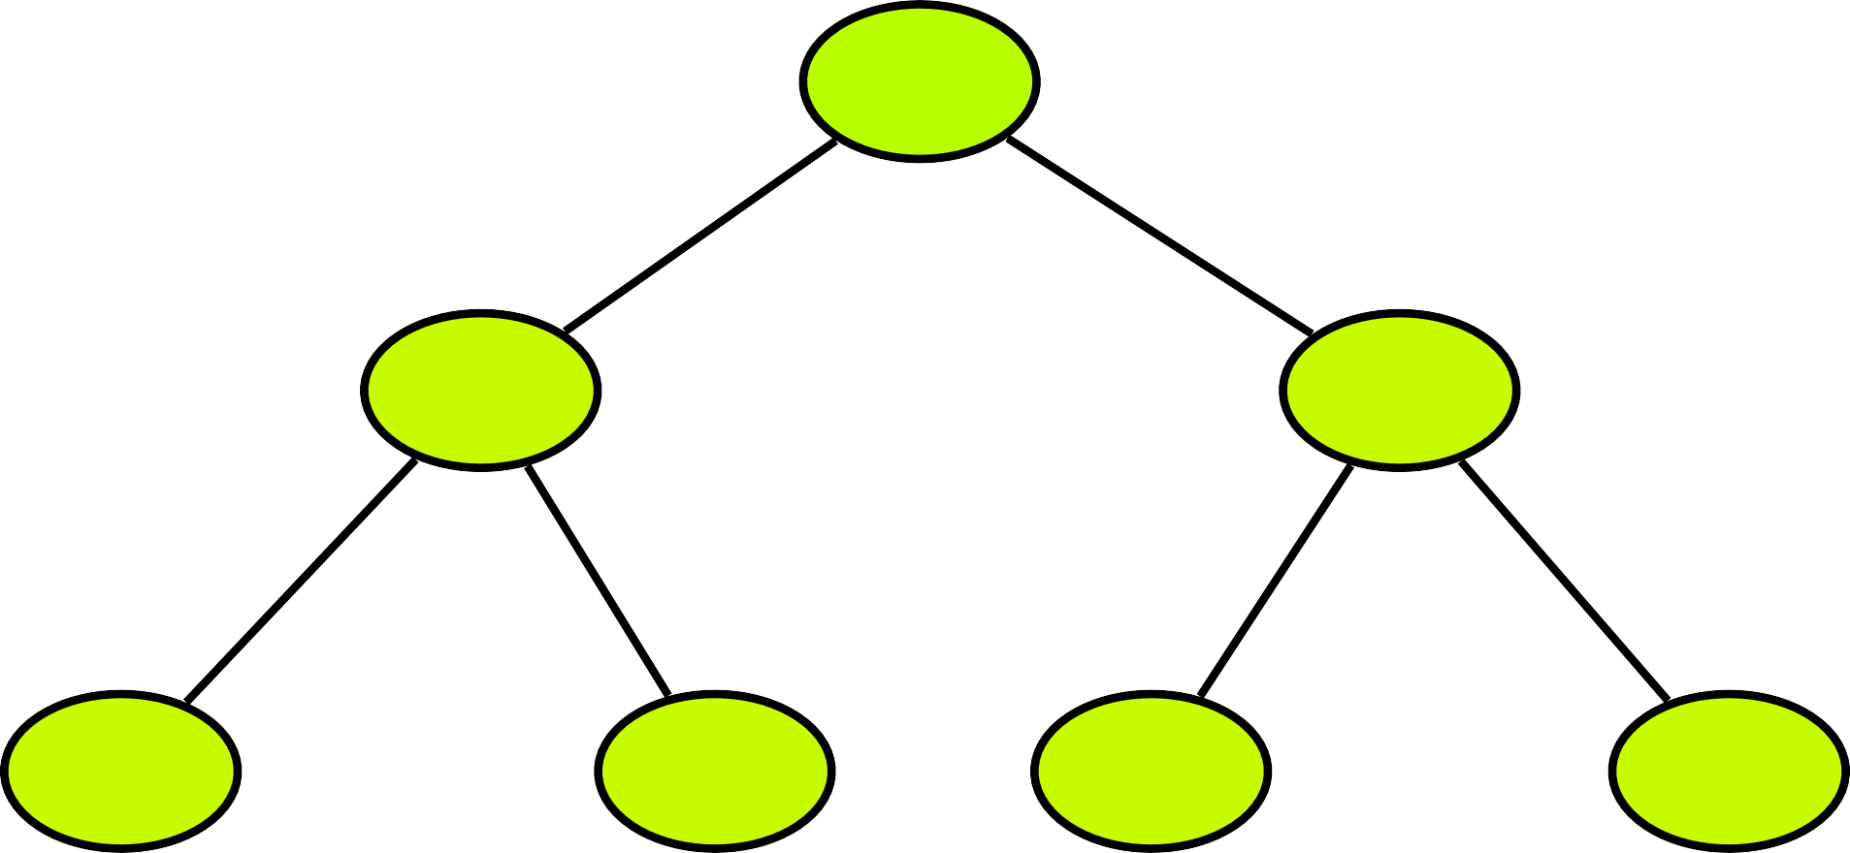
Types of Binary Tree
Perfect Binary Tree
N1
N2
N3
N4
N5
N6
N7

Slide 17
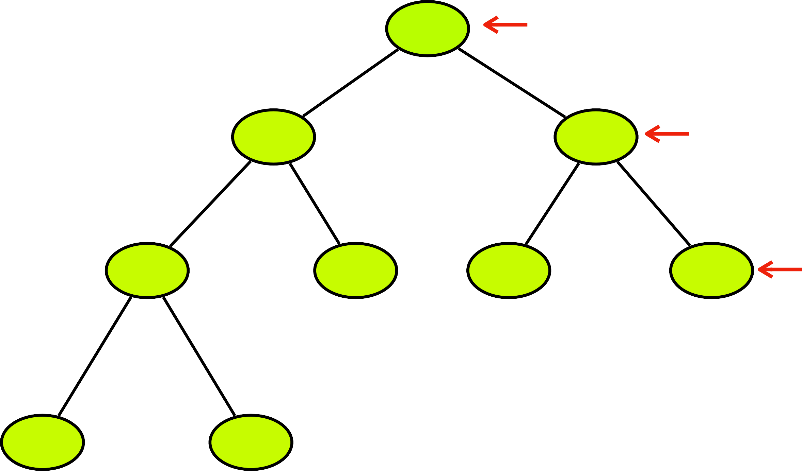
Types of Binary Tree
Complete Binary Tree
N1
N2
N3
N4
N5
N6
N7
N8
N9

Slide 18
Types of Binary Tree
Balanced Binary Tree
N1
N2
N3
N4
N5
N7

Slide 19
Binary Tree
Linked List
Array
Drinks
Hot
Cold
Tea
Coﬀee
Non alcoholic
Alcoholic

Slide 20
Binary Tree
Linked List
222
Drinks
333
111
444
Hot
555
666
Cold
777
222
333
null | Tea | null
null | Coffee | null
null | Cola | null
null | Fanta | null
444
555
666
777

Slide 21
Binary Tree
Array
Drinks
Hot
Cold
Tea
Coﬀee
Non alcoholic
Alcoholic
0
1
2
3
4
5
6
7
8
Left child = cell[2x]
Right child = cell[2x+1]

Slide 22
Binary Tree
Array
Drinks
Hot
Cold
Tea
Coﬀee
Non alcoholic
Alcoholic
0
1
2
3
4
5
6
7
8
 | Drinks | Hot | Cold
Left child = cell[2x]
x = 1 , cell[2x1=2]
Right child = cell[2x+1]
x = 1 , cell[2x1+1=3]

Slide 23
Binary Tree
Array
Drinks
Hot
Cold
Tea
Coﬀee
Non alcoholic
Alcoholic
0
1
2
3
4
5
6
7
8
 | Drinks | Hot | Cold | Tea | Coffee
Left child = cell[2x]
x = 2 , cell[2x2=4]
Right child = cell[2x+1]
x = 2, cell[2x2+1=5]

Slide 24
Binary Tree
Array
Drinks
Hot
Cold
Tea
Coﬀee
Non alcoholic
Alcoholic
0
1
2
3
4
5
6
7
8
 | Drinks | Hot | Cold | Tea | Coffee | Non alcoholic | Alcoholic
Left child = cell[2x]
x = 3 , cell[2x3=6]
Right child = cell[2x+1]
x = 3, cell[2x3+1=7]

Slide 25
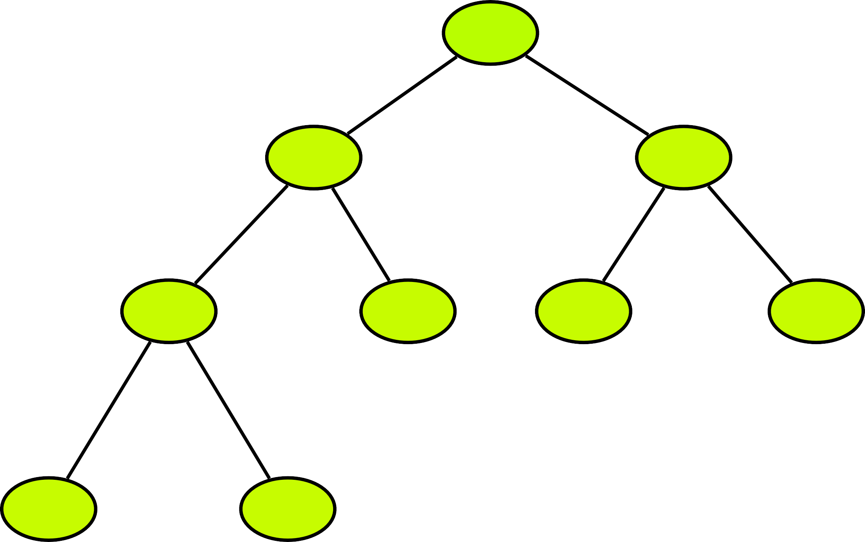
Binary Tree using Linked List
Creation of Tree
Insertion of a node
N1
Deletion of a node
Search for a value
Traverse all nodes
Deletion of tree
N2
N3
N4
N5
N6
N7
newTree = Tree()
N8
N9

Slide 26

Binary Tree - Traversal
N1
Depth first search
Preorder traversal
Inorder traversal
Post order traversal
Breadth first search
Level order traversal
N2
N3
N4
N5
N6
N7
N8
N9

Slide 27
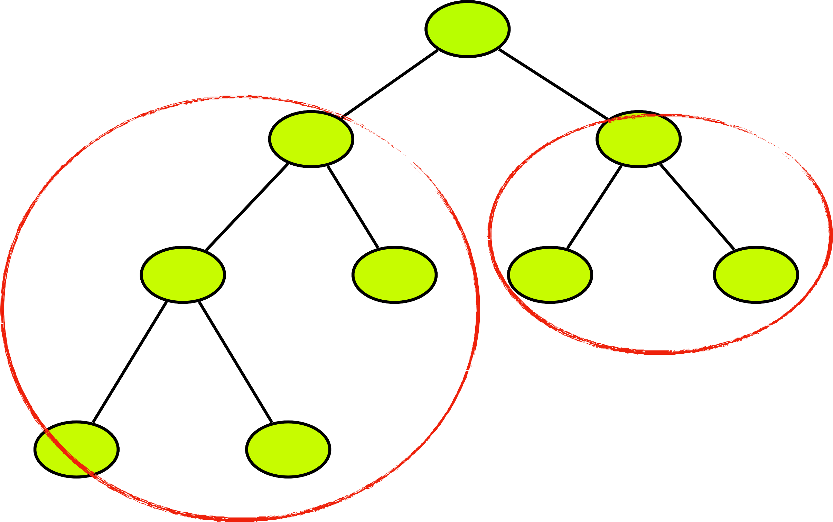
Binary Tree - PreOrder Traversal
N1
Root Node
N2
N3
Left Subtree
N4
N5
N6
N7
Right Subtree
N8
N9
N1
N2

Slide 28
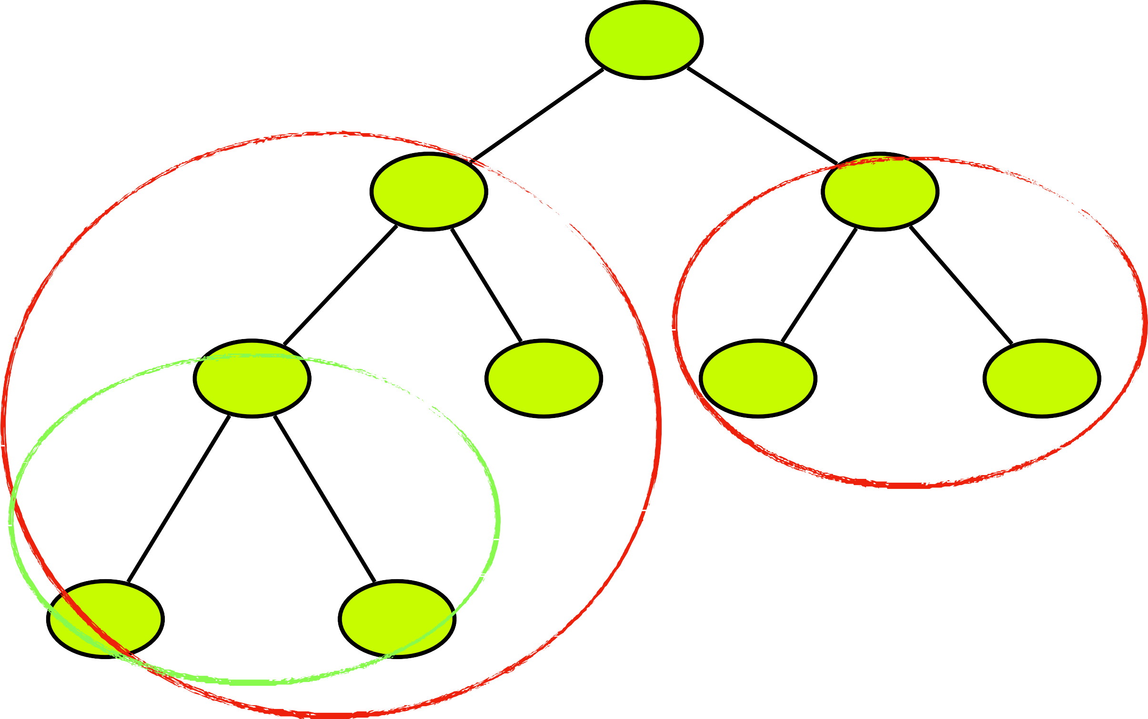
Binary Tree - PreOrder Traversal
N1
Root Node
N2
N3
Left Subtree
N4
N5
N6
N7
Right Subtree
N8
N9
N1
N2
N4
N8
N9

Slide 29
Binary Tree - PreOrder Traversal
N1
Root Node
N2
N3
Left Subtree
N4
N5
N6
N7
Right Subtree
N8
N9
N1
N2
N4
N8
N9
N5
N3
N6
N7

Slide 30
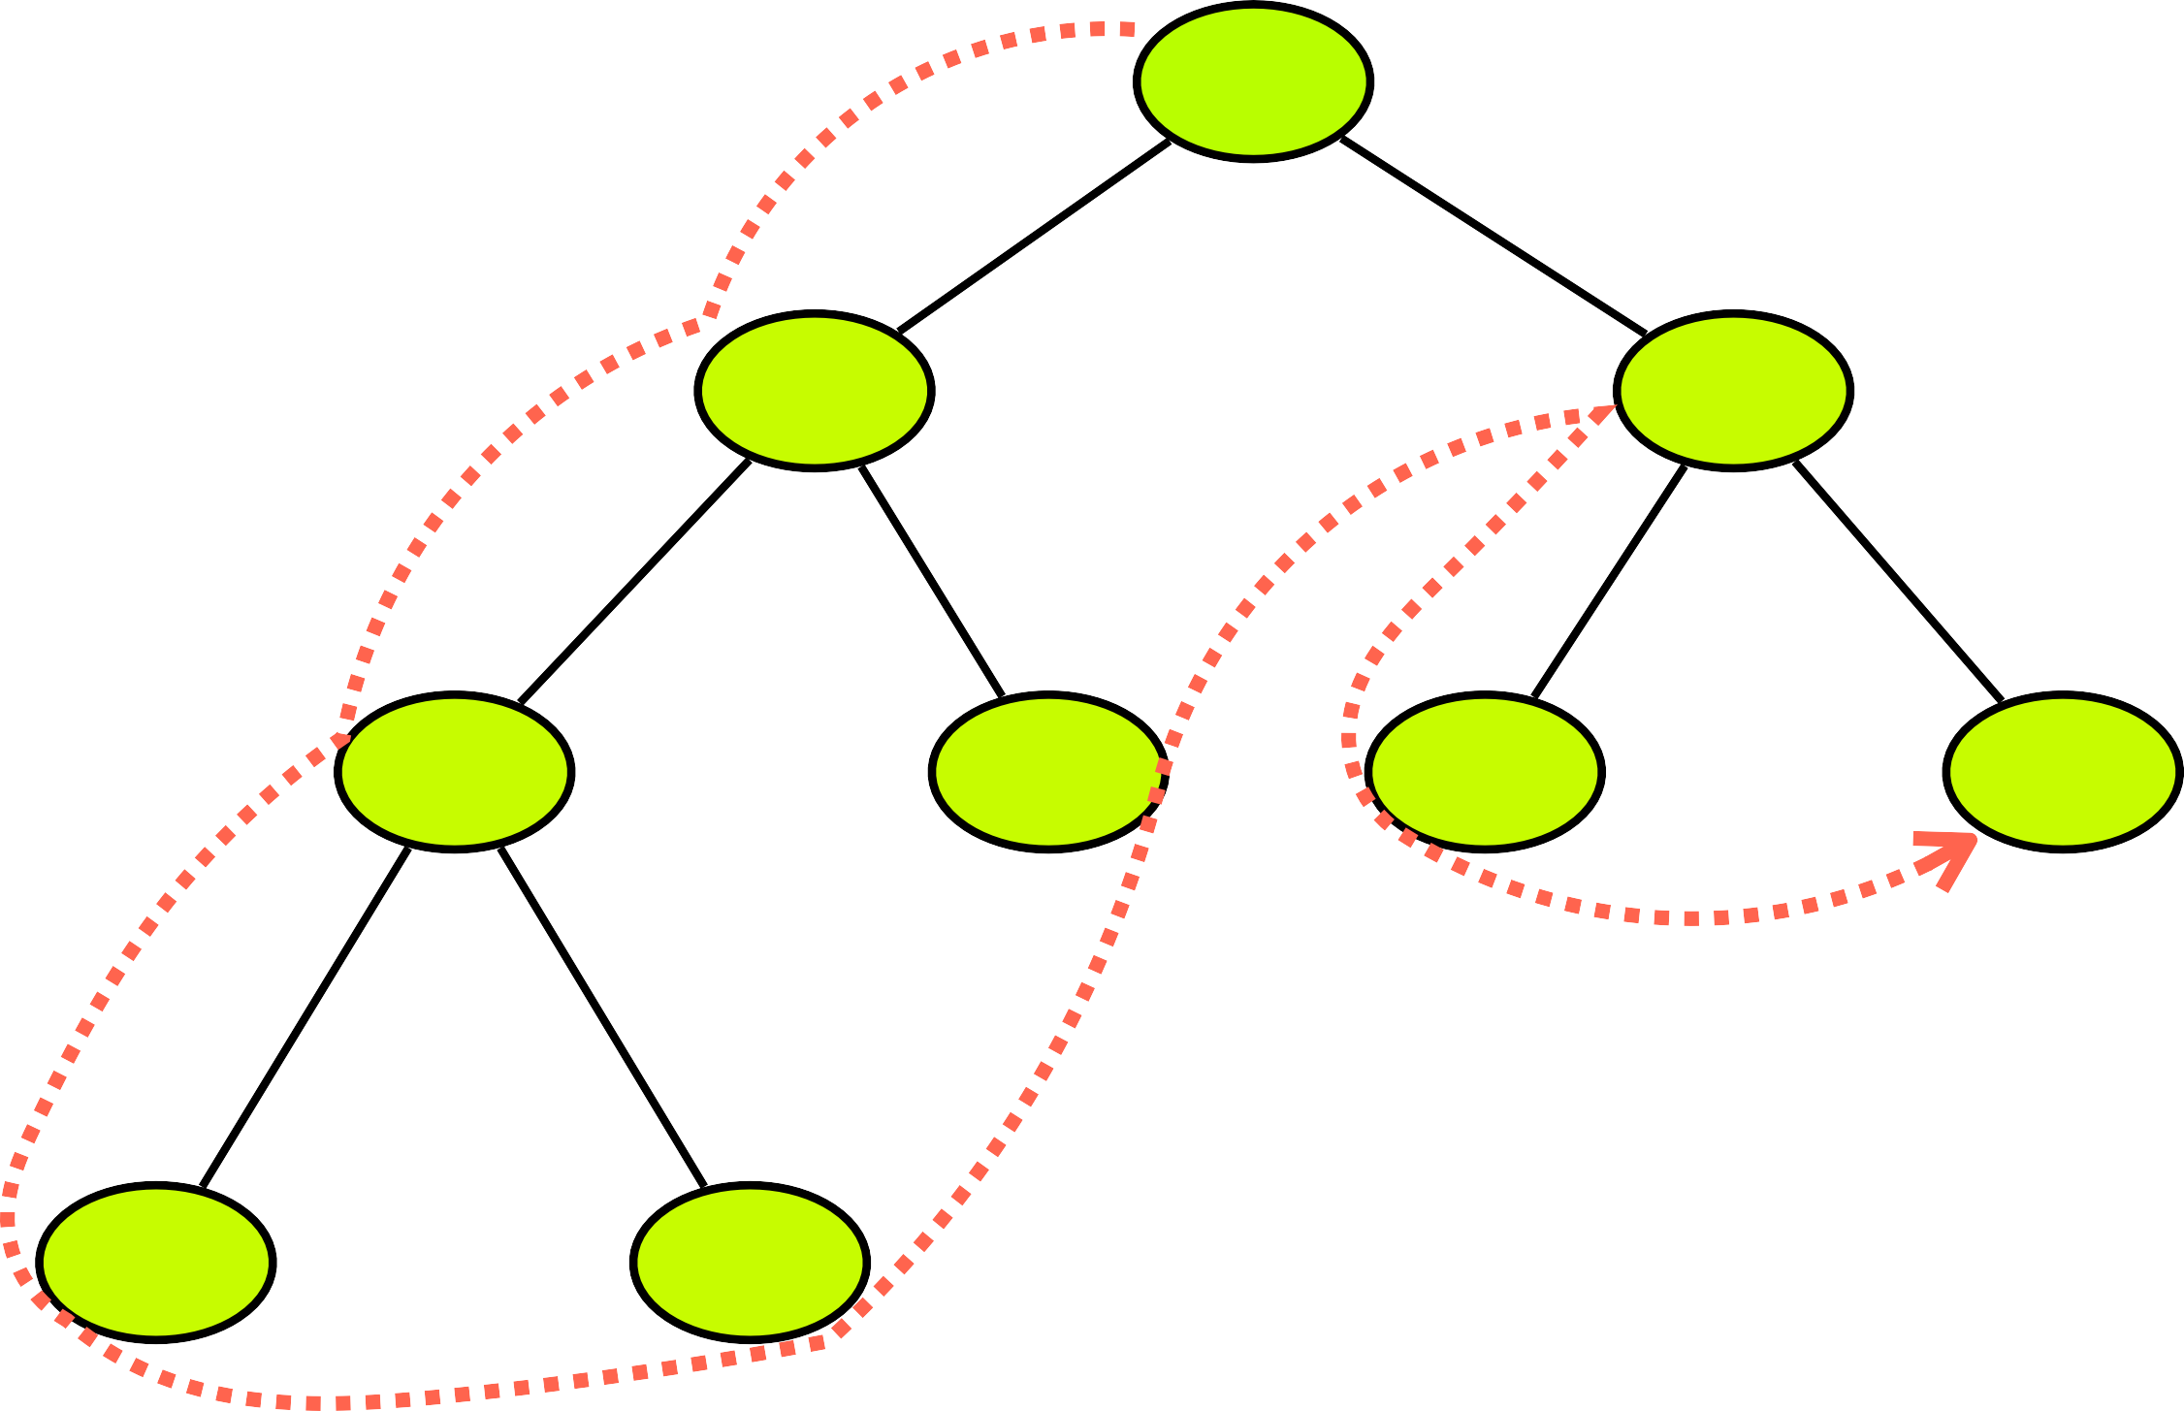
Binary Tree - PreOrder Traversal
N1
Root Node
N2
N3
Left Subtree
N4
N5
N6
N7
Right Subtree
N8
N9
N1
N2
N4
N8
N9
N5
N3
N6
N7

Slide 31

Binary Tree - PreOrder Traversal
N1
N2
N3
N4
N5
N6
N7
N8
N9
N1
N2
N4
N8
N9
N5
N3
N6
N7

Slide 32
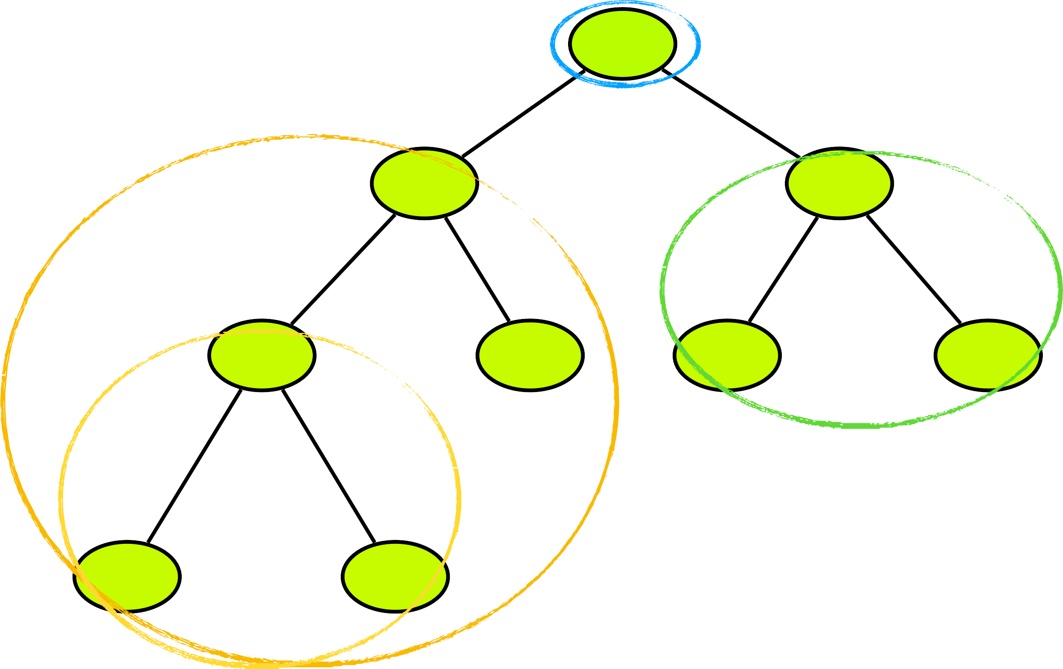
Binary Tree - InOrder Traversal
N1
Left Subtree
N2
N3
Root Node
N4
N5
N6
N7
Right Subtree
N8
N9
N8
N4

Slide 33
Binary Tree - InOrder Traversal
N1
Left Subtree
N2
N3
Root Node
N4
N5
N6
N7
Right Subtree
N8
N9
N8
N4
N9
N2
N5

Slide 34
Binary Tree - InOrder Traversal
N1
Left Subtree
N2
N3
Root Node
N4
N5
N6
N7
Right Subtree
N8
N9
N9
N4
N9
N2
N5
N1
N6
N3
N7

Slide 35
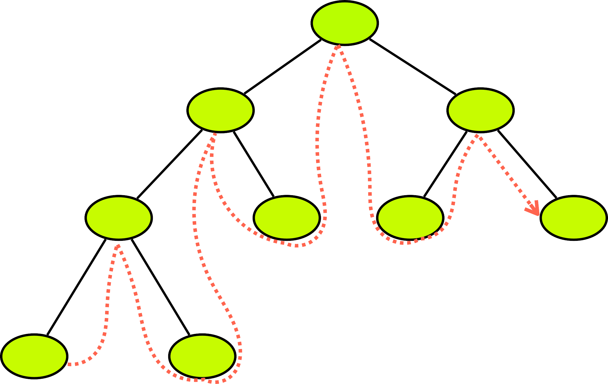
Binary Tree - InOrder Traversal
N1
Left Subtree
N2
N3
Root Node
N4
N5
N6
N7
Right Subtree
N8
N9
N9
N4
N9
N2
N5
N1
N6
N3
N7

Slide 36

Binary Tree - InOrder Traversal
N1
N2
N3
N4
N5
N6
N7
N8
N9
N8
N4
N9
N2
N5
N1
N6
N3
N7

Slide 37
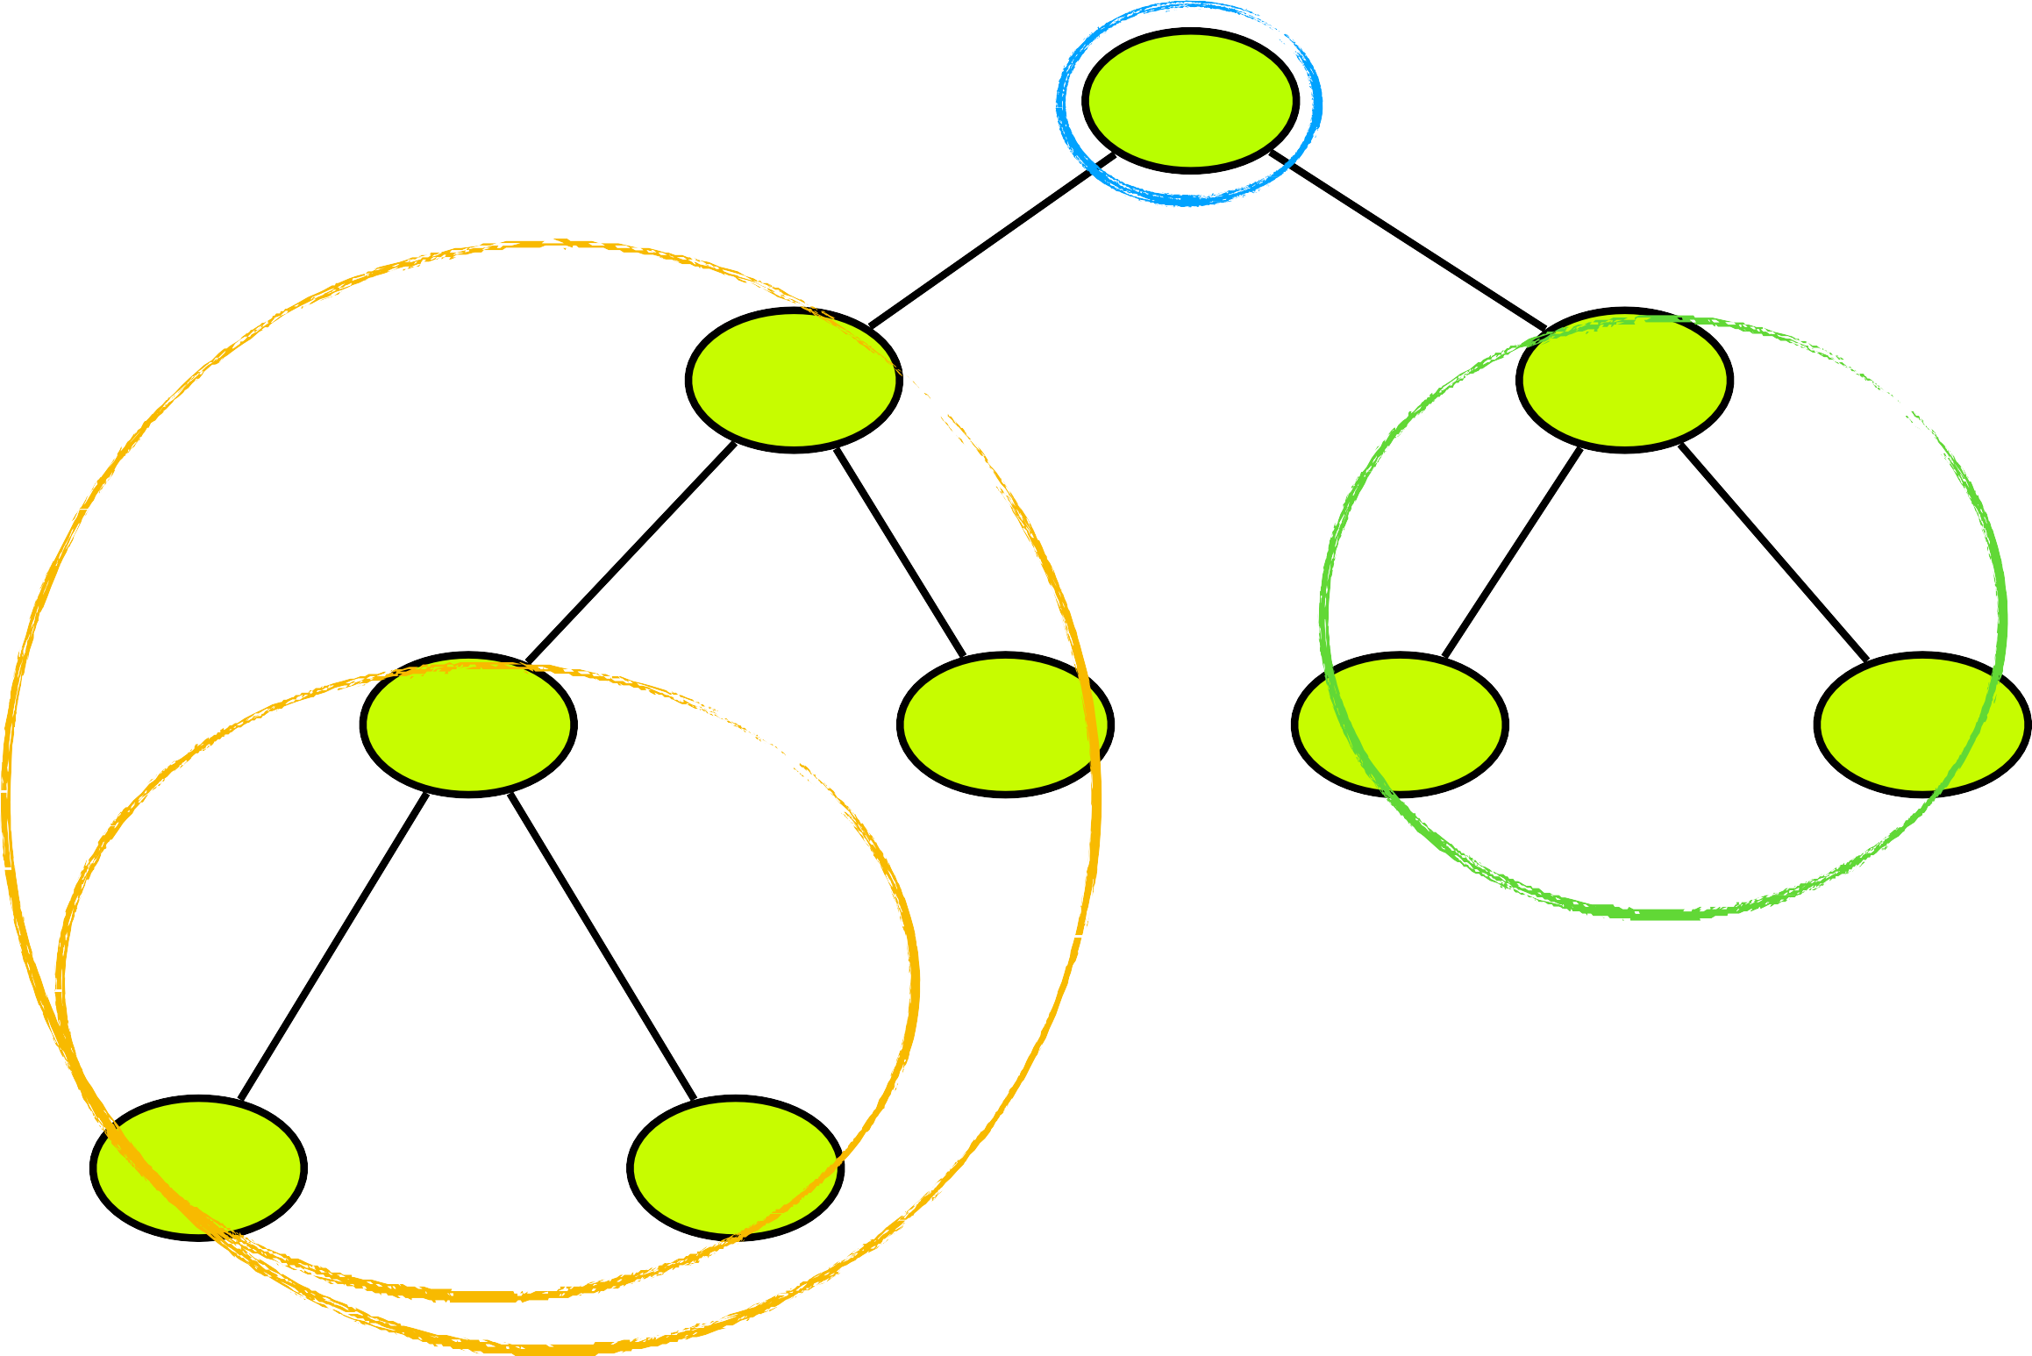
Binary Tree - Post Traversal
N1
Left Subtree
N2
N3
Right Subtree
N4
N5
N6
N7
Root Node
N8
N9
N8
N9

Slide 38
Binary Tree - Post Traversal
N1
Left Subtree
N2
N3
Right Subtree
N4
N5
N6
N7
Root Node
N8
N9
N8
N9
N4
N5
N2

Slide 39
Binary Tree - Post Traversal
N1
Left Subtree
N2
N3
Right Subtree
N4
N5
N6
N7
Root Node
N8
N9
N8
N9
N4
N5
N2
N6
N7
N3
N1

Slide 40
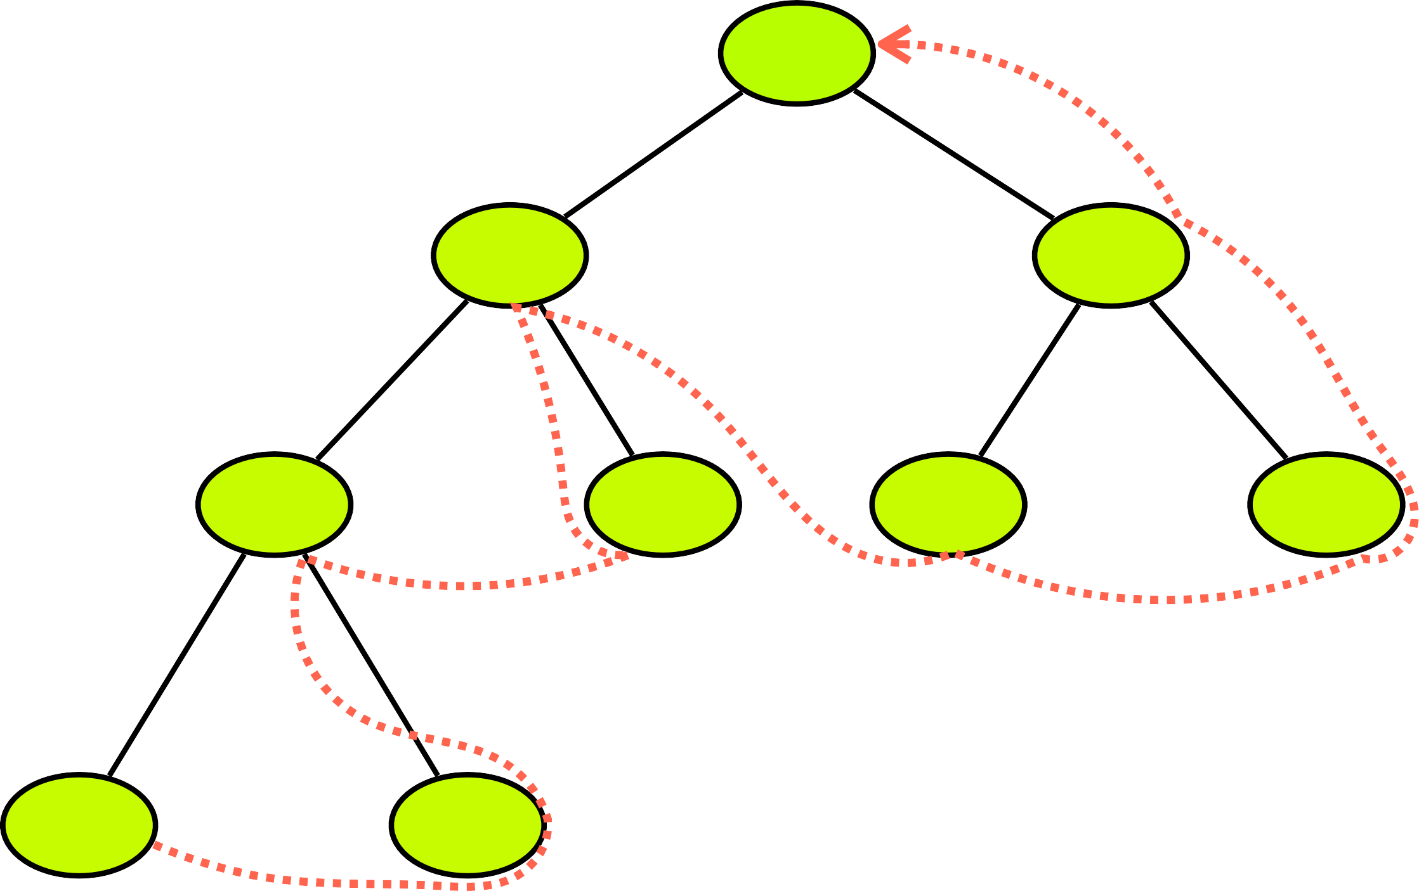
Binary Tree - Post Traversal
N1
Left Subtree
N2
N3
Right Subtree
N4
N5
N6
N7
Root Node
N8
N9
N8
N9
N4
N5
N2
N6
N7
N3
N1

Slide 41

Binary Tree - Post Traversal
N1
N2
N3
N4
N5
N6
N7
N8
N9
N8
N9
N4
N5
N2
N6
N7
N3
N1

Slide 42
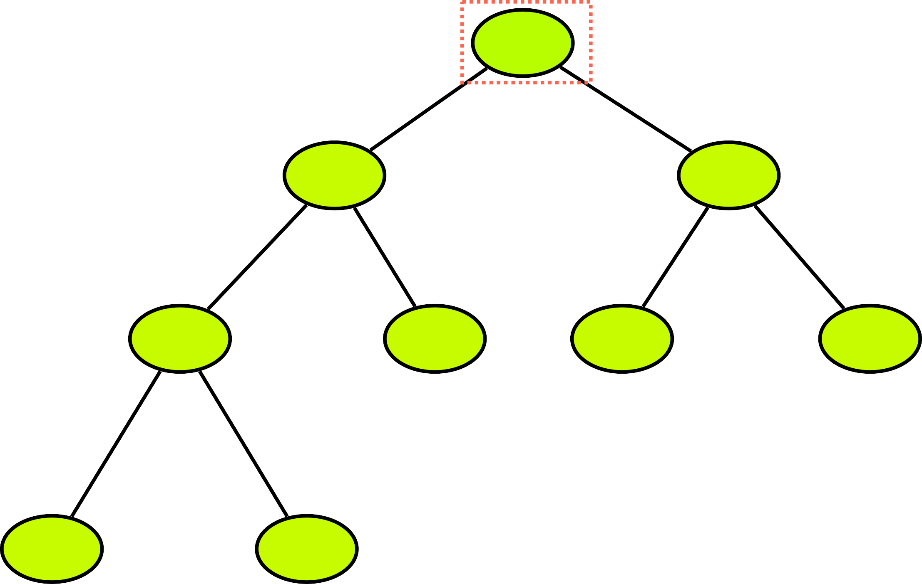
Binary Tree - LevelOrder Traversal
Level 1
N1
N2 N3
Level 2
N4 N5 N6 N7
Level 3
N8 N9
Level 4

Slide 43
Binary Tree - LevelOrder Traversal
Level 1
N1
N2 N3
Level 2
N4 N5 N6 N7
Level 3
N8 N9
Level 4
N1
N2
N3
N4
N5

Slide 44
Binary Tree - LevelOrder Traversal
Level 1
N1
N2 N3
Level 2
N4 N5 N6 N7
Level 3
N8 N9
Level 4
N1
N2
N3
N4
N5
N6
N7
N8
N9

Slide 45
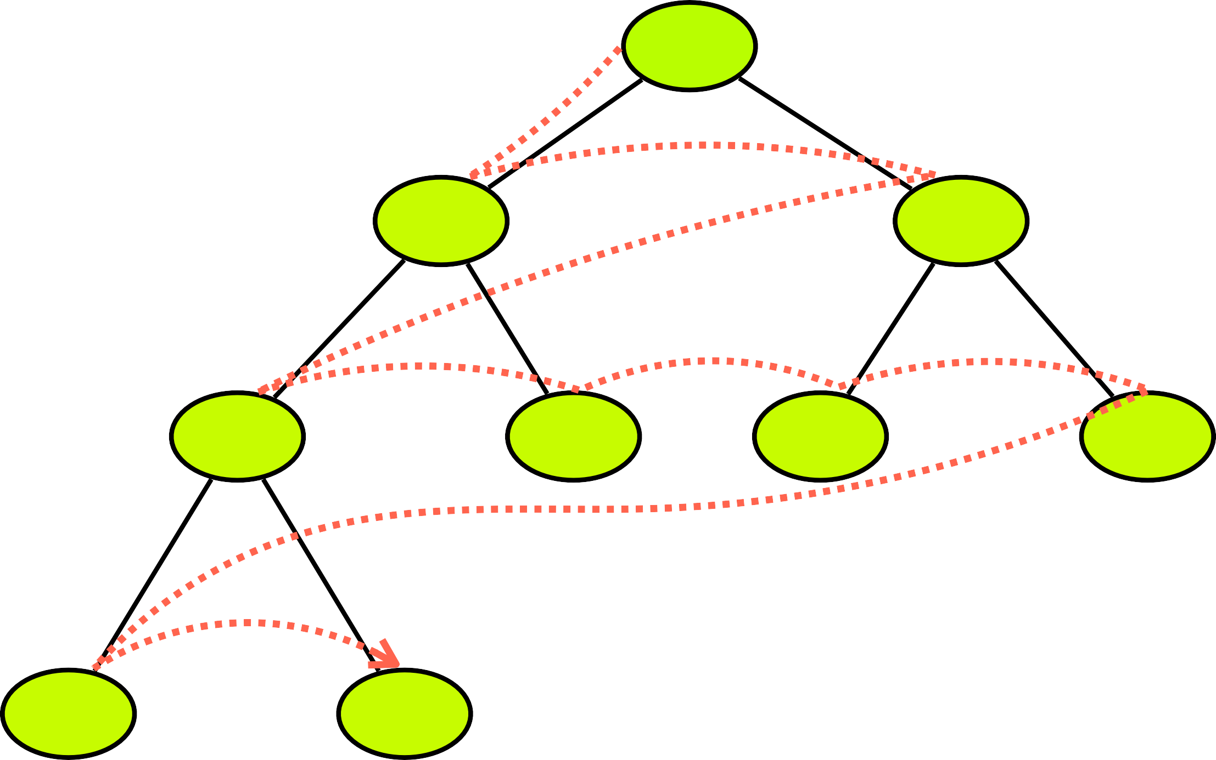
Binary Tree - LevelOrder Traversal
N1
N2
N3
N4
N5
N6
N7
N8
N9
N1
N2
N3
N4
N5
N6
N7
N8
N9

Slide 46
Binary Tree - Search
Level Order Traversal
Level 1
N1
N5
Success
N2 N3
Level 2
N4 N5 N6 N7
Level 3
N8 N9
Level 4

Slide 47
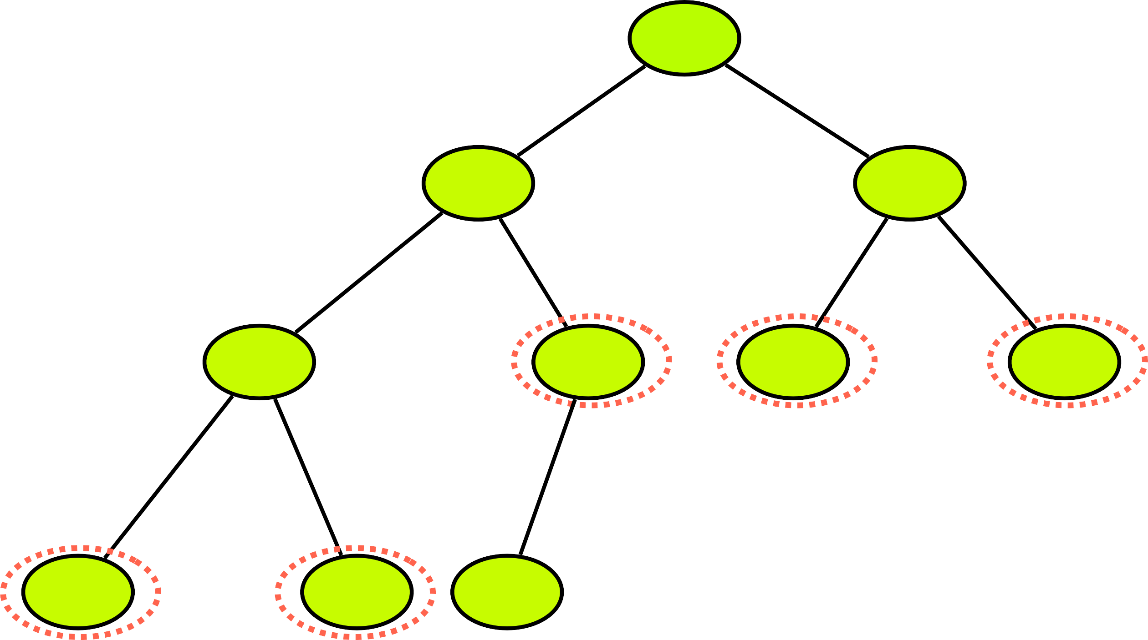
Binary Tree - Insert a Node
- A root node is null
N1
- The tree exists and we have to look for a first vacant place
N2
N3
Level Order Traversal
N4
N5
N6
N7
newNode
N8
N9
N10

Slide 48
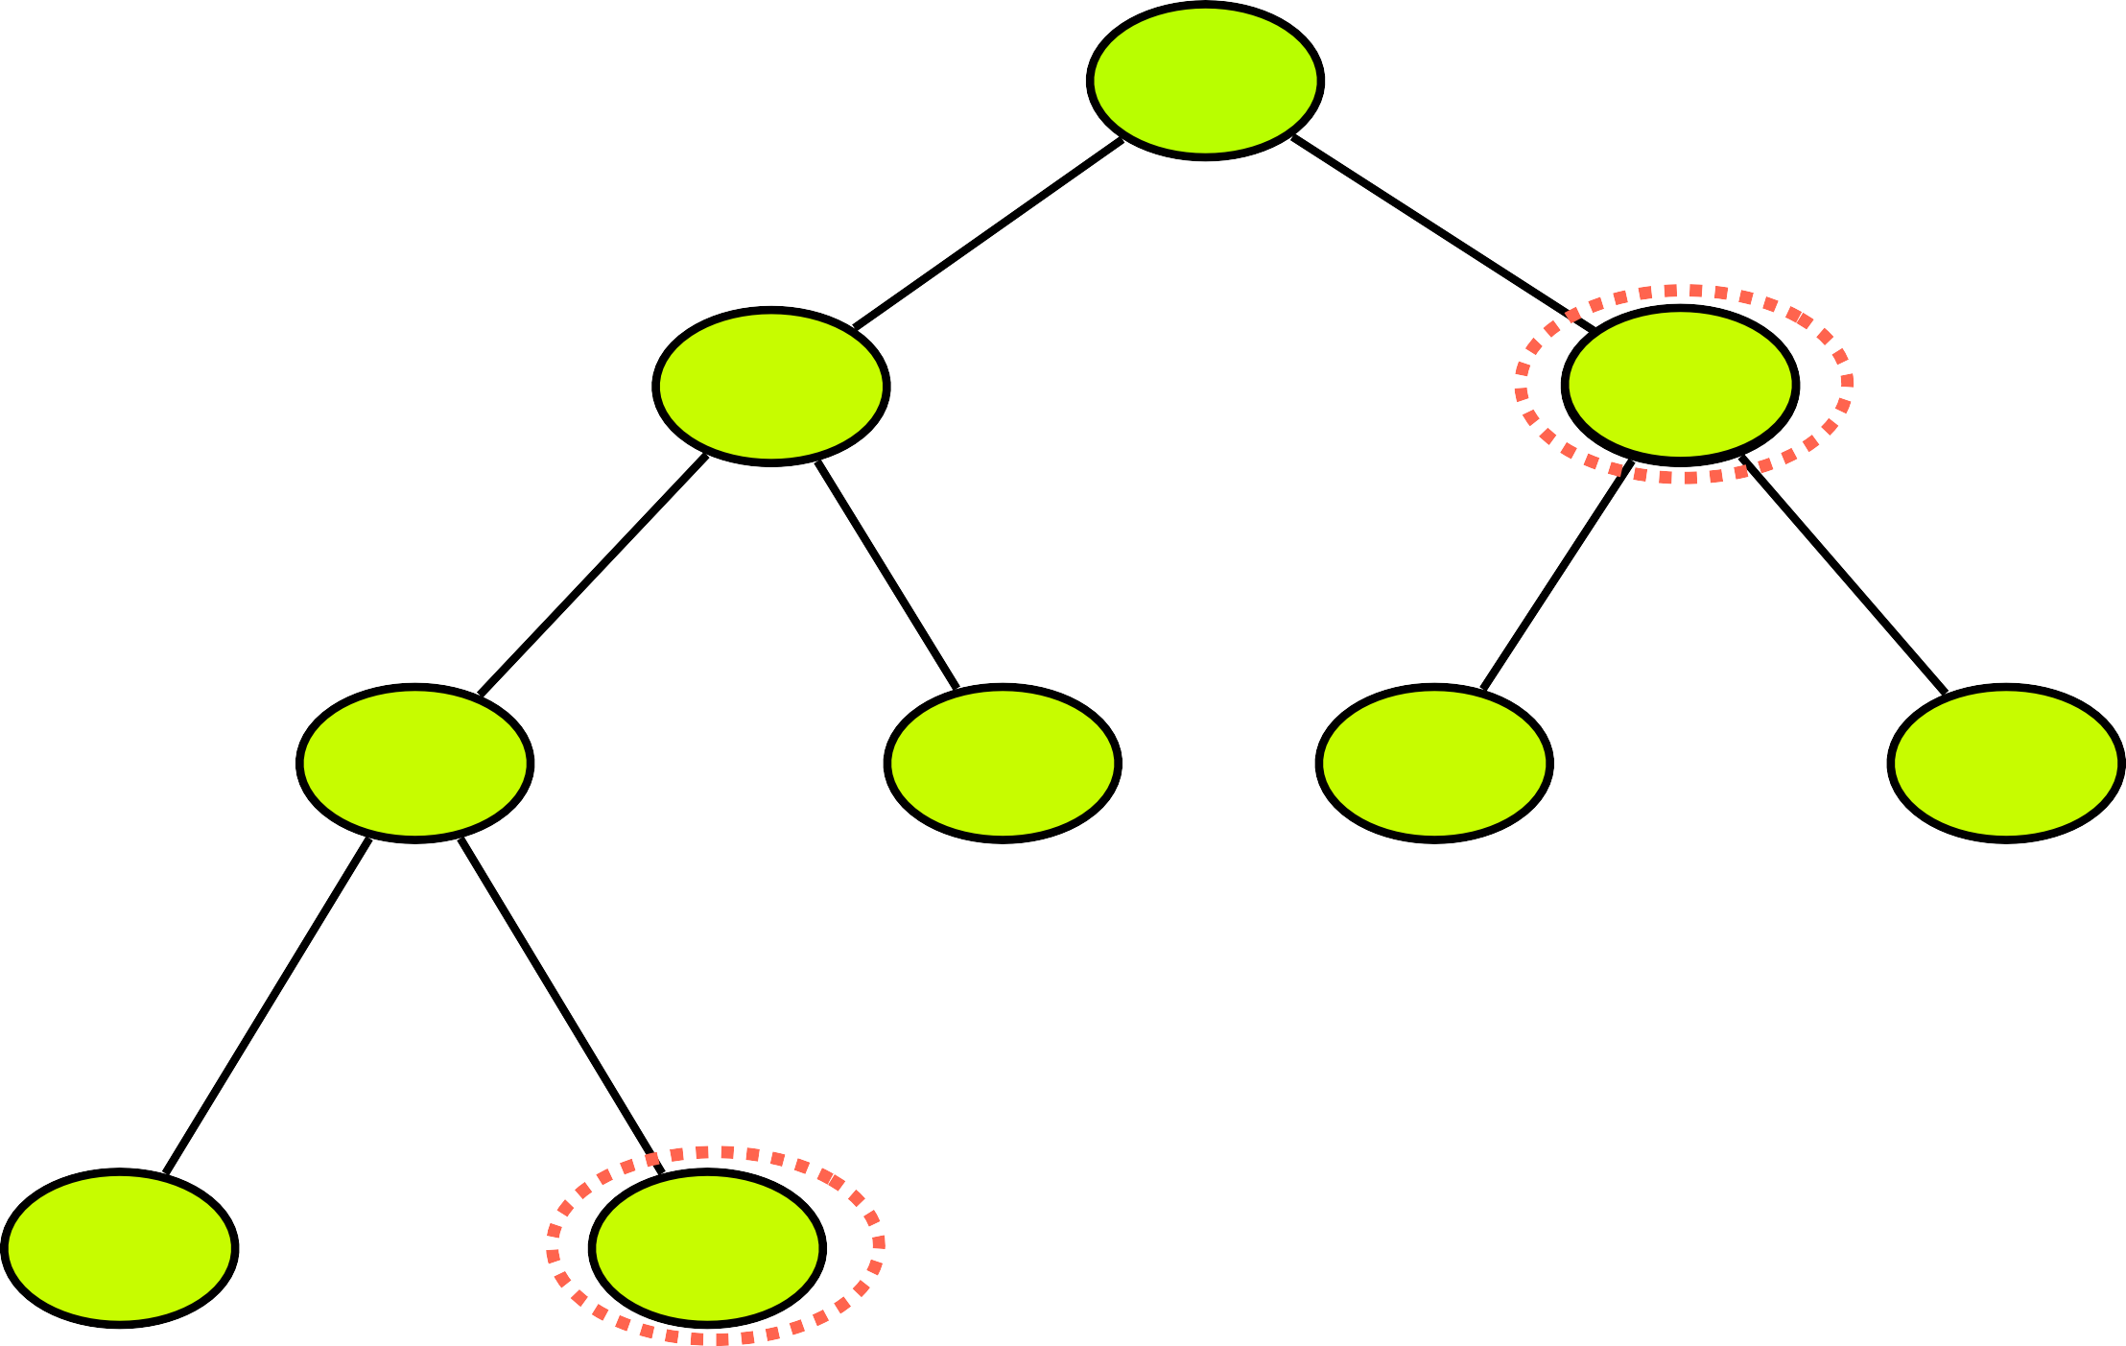
Binary Tree - Delete a Node
Level Order Traversal
N1
N3
Step 1 - Find the Node
Step 2 - Find Deepest Node
Step 3 - Set Deepest Node’s value to Current Node Step 4 - Delete Deepest Node
N2
N93
N4
N5
N6
N7
N8
N9

Slide 49

Binary Tree - Delete Binary Tree
rootNode = Null
N1
N2
N3
N4
N5
N6
N7
N8
N9

Slide 50

Binary Tree using Array
Creation of Tree
Insertion of a node
Deletion of a node
N1
N2
N3
Search for a value
Traverse all nodes
Deletion of tree
N4
N5
N6
N7

Slide 51
Binary Tree using Array
N1
N2
N3
N4
N5
N6
N7
0
1
2
3
4
5
6
7
8
Left child = cell[2x]
Right child = cell[2x+1]

Slide 52

Binary Tree using Array
N1
N2
N3
N4
N5
N6
N7
0
1
2
3
4
5
6
7
8
 | N1 | N2 | N3
Left child = cell[2x]
x = 1 , cell[2x1=2]
Right child = cell[2x+1]
x = 1 , cell[2x1+1=3]

Slide 53
Binary Tree using Array
N1
N2
N3
N4
N5
N6
N7
0
1
2
3
4
5
6
7
8
 | N1 | N2 | N3 | N4 | N5
Left child = cell[2x]
x = 2 , cell[2x2=4]
Right child = cell[2x+1]
x = 2, cell[2x2+1=5]

Slide 54
Binary Tree using Array
newBT = BTclass()
Fixed size Array lastUsedIndex
N1
N2
N3
N4
N5
N6
N7
0
1
2
3
4
5
6
7
8
 | N1 | N2 | N3 | N4 | N5 | N6 | N7
Left child = cell[2x]
x = 3 , cell[2x3=6]
Right child = cell[2x+1]
x = 3, cell[2x3+1=7]

Slide 55
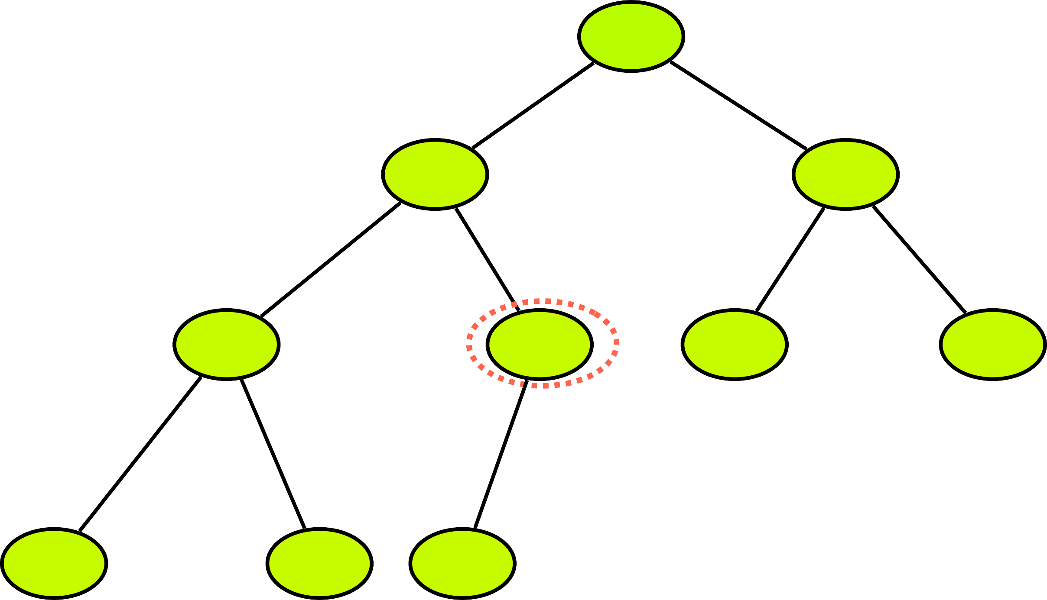
Binary Tree (Array) - Insert a Node
- The Binary Tree is full
N1
- We have to look for a first vacant place
lastUsedIndex = 9
newNode Index = 10
Left child = cell[2x] indexOfParent = 10/2 = 5
N2
N3
N4
N5
N6
N7
N8
N9
New
0
1
2
3
4
5
6
7
8
9
10
11
 | N1 | N2 | N3 | N4 | N5 | N6 | N7 | N8 | N9 | New

Slide 56
Binary Tree (Array) - Traversal
N1
Depth first search
- Preorder traversal
Inorder traversal
Post order traversal
Breadth first search
Level order traversal
N2
N3
N4
N5
N6
N7
N8
N9

Slide 57



Binary Tree (Array) - PreOrder Traversal
N1
Root Node
N2
N3
Left Subtree
N4
N5
N6
N7
Right Subtree
N8
N9

Slide 58
Binary Tree (Array) - PreOrder Traversal
N1
Root Node
N2
N3
Left Subtree
N4
N5
N6
N7
Right Subtree
N8
N9

Slide 59

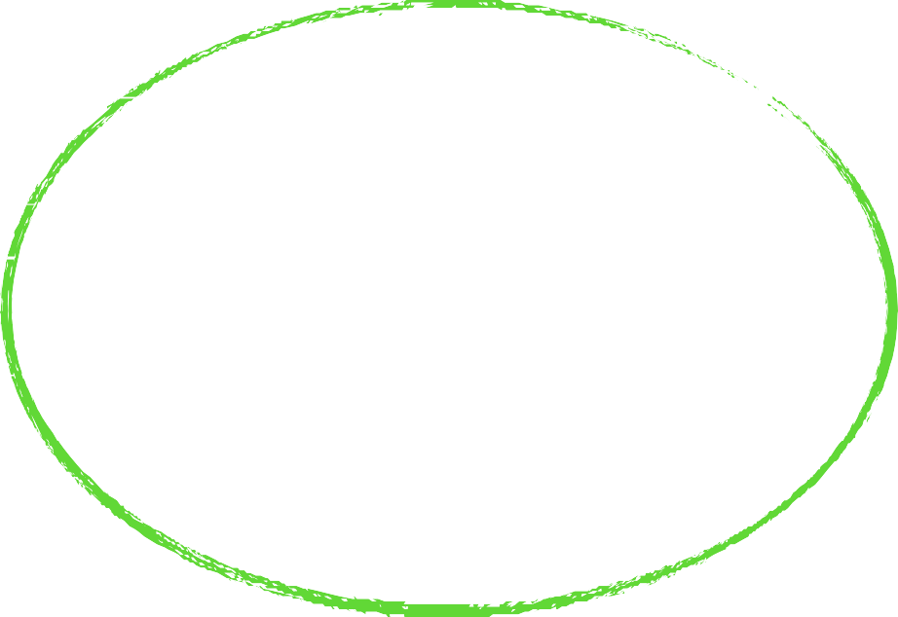
Binary Tree (Array) - InOrder Traversal
N1
Left Subtree
N2
N3
Root Node
N4
N5
N6
N7
Right Subtree
N8
N9

Slide 60
Binary Tree (Array) - InOrder Traversal
N1
Left Subtree
N2
N3
Root Node
N4
N5
N6
N7
Right Subtree
N8
N9

Slide 61



Binary Tree (Array) - Post Traversal
N1
Left Subtree
N2
N3
Right Subtree
N4
N5
N6
N7
Root Node
N8
N9

Slide 62
Binary Tree (Array) - Post Traversal
N1
Left Subtree
N2
N3
Right Subtree
N4
N5
N6
N7
Root Node
N8
N9

Slide 63
Binary Tree (Array) - LevelOrder Traversal
Level 1
N1
N2 N3
Level 2
N4 N5 N6 N7
Level 3
N8 N9
Level 4

Slide 64
Binary Tree - LevelOrder Traversal
N1
N2
N3
N4
N5
N6
N7
N8
N9

Slide 65
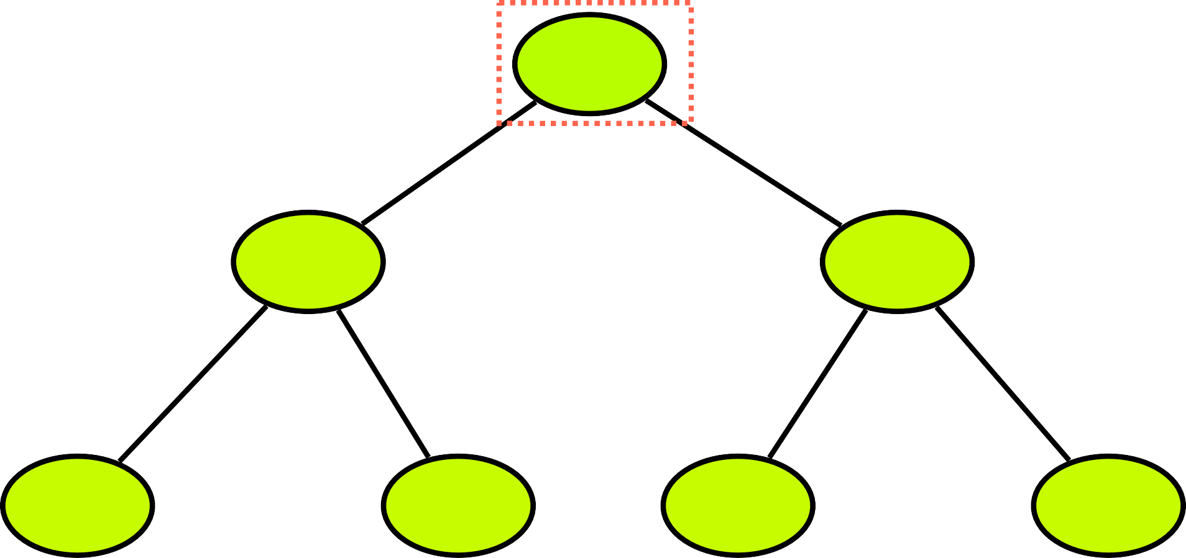
Binary Tree (Array) - Search
Level Order Traversal
Level 1
N1
N5
5
N2 N3
Level 2
N4 N5 N6 N7
Level 3
0
1
2
3
4
5
6
7
8
 | N1 | N2 | N3 | N4 | N5 | N6 | N7

Slide 66
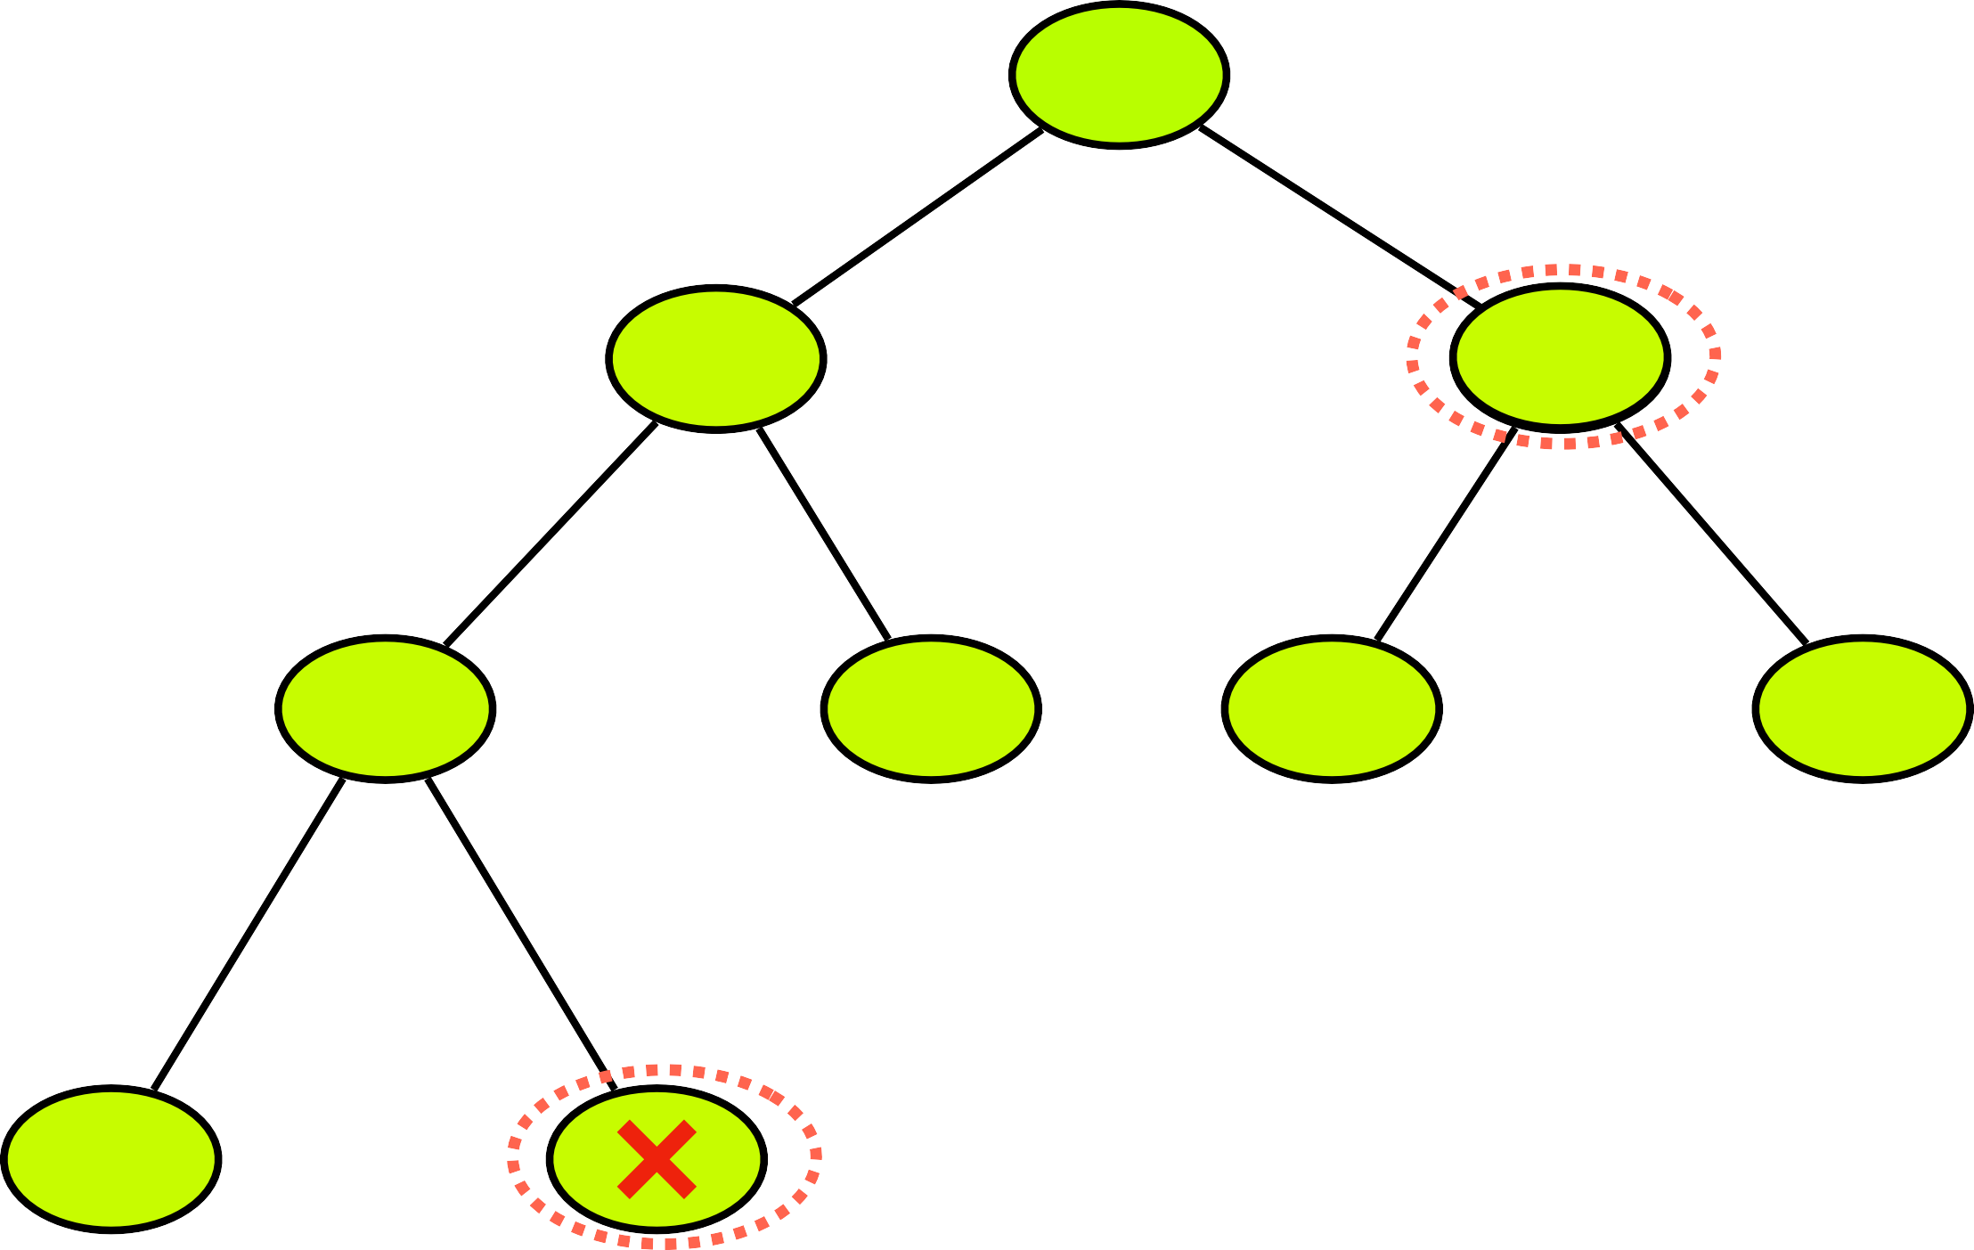
Binary Tree (Array) - Delete a Node
Level Order Traversal
N1
N3
N2
N93
deepestNode = lastUsedIndex
N4
N5
N6
N7
N8
N9
 | N1 | N2 | N9 | N4 | N5 | N6 | N7 | N8 | N9
N3
0
1
2
3
4
5
6
7
8
9
10
11

Slide 67
Binary Tree (Array) - Delete Binary Tree
arr = Null
N1
N2
N3
N4
N5
N6
N7
N8
N9

Slide 68
Binary Tree (Array vs Linked List)
 | Array |  | Linked List
Create Binary Tree | Time complexity | Space complexity | Time complexity | Space complexity
 | O(1) | O(n) | O(1) | O(1)
Insert a node to Binary Tree | O(1) | O(1) | O(n) | O(n)
Delete a node from Binary Tree | O(n) | O(1) | O(n) | O(n)
Search for a node in Binary Tree | O(n) | O(1) | O(n) | O(n)
Traverse Binary Tree | O(n) | O(1)/O(n) | O(n) | O(n)
Delete entire Binary Tree | O(1) | O(1) | O(1) | O(1)
Space efficient? | No |  | Yes

